Slide 1
Architecture Walkthrough of a Spring JPA /Hibernate Application

Slide 2

Architecture

Slide 3
Model-View-Controller
Controller
User Events
View Selection
Change
View
Report Change
Model
Query

Slide 4
Model-View-Controller
Controller
View
Model

Slide 5

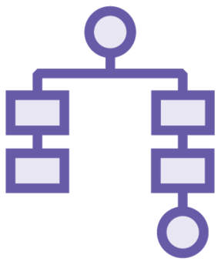

Separation of concerns
Reusable layers Maintenance
Presentation Layer
Business Logic
Data Layer

Slide 6
View (JSPs)
Controller (@Controller)
Data Model / Database (Model Object)

Slide 7


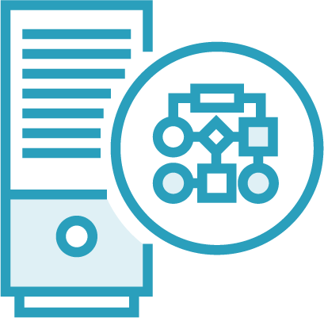
Components

Slide 8

Handles request/response
No business logic
Coordinate with service and repository
Annotated with @Controller
Handles exceptions and view routing
Controller

Slide 9
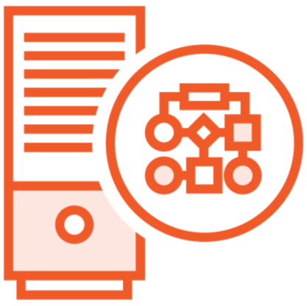
Annotated with @Service
Describes verbs/actions of system Business logic belongs here Ensures business object state Transactional
Service
Often same methods as repository

Slide 10

Annotated with @Repository
Nouns (data) of the system Database interaction
One-to-one object mapping
Often one-to-one database table mapping
Repository

Slide 11
Software architecture
MVC
Summary
N-tier
Components Controller Service Repository

